Slide 1
An Introduction to Grammar, Punctuation and Spelling
Often referred to as GAPs or SPAG

Slide 2
We are going to be looking at the government expectations, but through good classroom practice, we will always differentiate and pace our learning to best suit the needs of your child.

Slide 3
New Spelling Expectations
The spellings are taught on a rotation, covering half one year and half the next.

Slide 4
Key Stage 2 Spellings (Year 3/4/5/6)
Key Stage two focus on a weekly spelling pattern, for example, a suffix or a prefix. They also have a dictation to help to practice additional key words and to practice their grammar point.

Slide 5
Spellings in Key Stage 1 (Year 1/2)
Spellings is taught predominantly through phonics, using a programme called “Letters and Sounds”
Throughout the week, children will focus on given sounds, both reading and writing them.
They progress to teacher given dictations, practicing using the spelling pattern within a sentence.

Slide 6
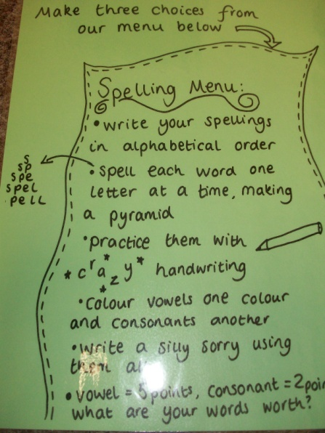
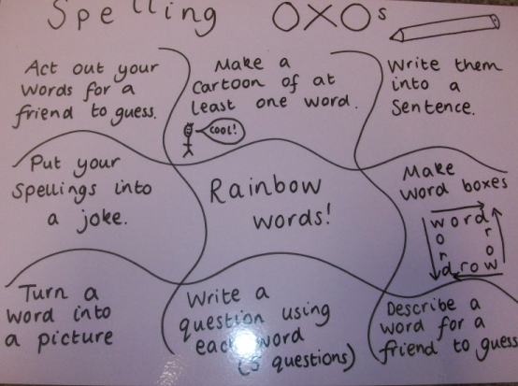
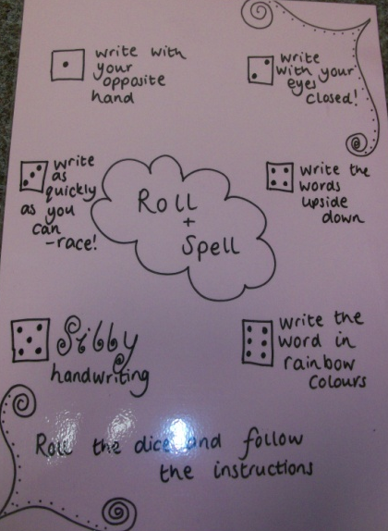
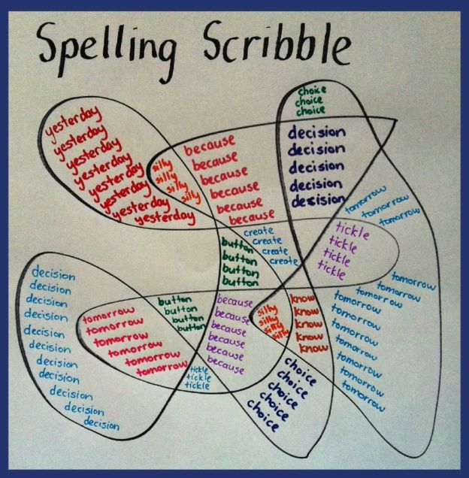
Some Spelling Activities:
Using websites:
(Google: “letters and sounds” for KS1, or BBC Bitesize has lots for both spelling and grammar for KS2)
Playing games such as hangman
Making deliberate mistakes and getting the children to correct you (play teacher)
Give the children the opportunity to write the spellings in more creative ways (capitals, different colours etc.)
Highlight the spelling patterns as you read together

Slide 7
Punctuation Pyramid

Slide 8
KS1 Expectations:

Slide 9
KS1 Expectations:

Slide 10
KS2 Expectations:

Slide 11
KS2 Expectations:

Slide 12
Punctuation, Spelling and Grammar is not just reserved for one lesson a week, the children should be including their learning into their own independent writing.

Slide 13
Suffix
Subordinate clauses
Colons
Synonyms
Possessive Pronouns
Articles
Adjectives
Determiners
Prepositions
Adverbs
Verbs
Proper Nouns
Hyphens
Root Word
Collective Nouns
Conjunctions
Abstract Nouns
Apostrophes
Pronouns
Prefix
Website

